Slide 1







Session 2:
Variational algorithm design
Organizers
Aritra Bose, PhD
IBM Research
Laxmi Parida, PhD
IBM Research
Hakan Doga, PhD
IBM Quantum
Filippo Utro, PhD
IBM Research

Slide 2
Learning outcomes of Session 2
Learning different transpilation strategies for quantum circuits
Running noiseless simulations with the primitives
Learning how to submit a job to a quantum backend
Learning the overall structure of variational quantum algorithms (VQAs)
Analyzing the individual components for problem-specific VQAs
Learning and proving the variational theorem of quantum mechanics
Understanding how to train parametrized circuits for quantum machine learning applications
Different encoding methods for data loading
More in-depth discussion about implementing quantum support vector classifiers (QSVC)
IBM Quantum

Slide 3
Variational quantum algorithms (VQA)
Near-term hybrid quantum-classical algorithms based on the variational theorem of quantum mechanics
These algorithms can leverage the utility provided by today's non-fault-tolerant quantum computers, making them ideal candidates to achieve quantum advantage
Variational algorithms are very commonly used in near term quantum optimization and quantum machine learning (QML) algorithms in various forms.
Variational algorithms include several modular components that can be combined and optimized based on algorithm, software, and hardware advancements
IBM Quantum

Slide 4
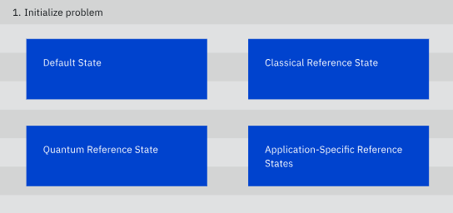
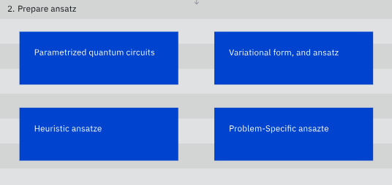

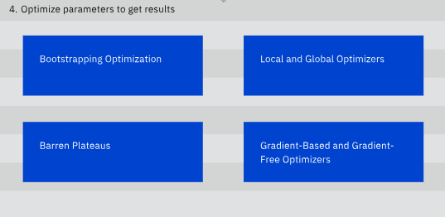
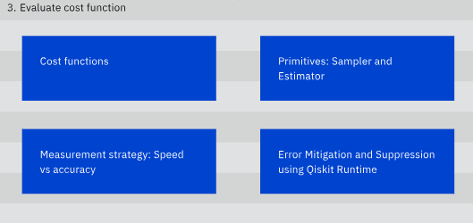
A typical simplified hybrid workflow
IBM Quantum

Slide 5
Components of VQA
Most common components are:
A cost function that describes a specific problem with a set of parameters,
An ansatz to express the search space with these parameters,
An optimizer to iteratively explore the search space.
During each iteration, the optimizer evaluates the cost function with the current parameters and selects the next iteration's parameters until it converges on an optimal solution. The hybrid nature of this family of algorithms comes from the fact that the cost functions are evaluated using quantum resources and optimized through classical ones.
IBM Quantum

Slide 6
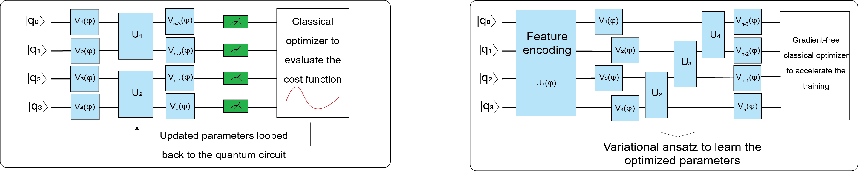
Variational quantum algorithms
A typical variational circuit setup
for optimization problems
A typical variational circuit setup
for machine learning problems
IBM Quantum

Slide 7
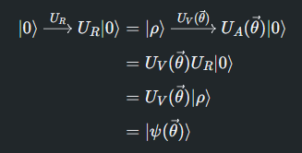

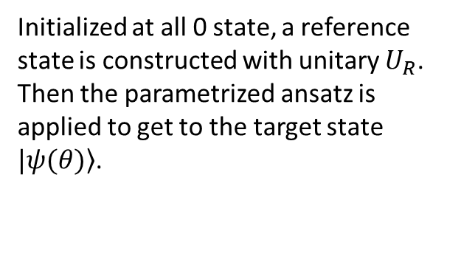
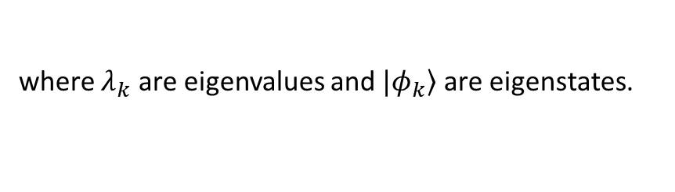
Why does this work?
A small digression into mathematics and quantum mechanics:
Initialized at all 0 state, a reference state is constructed with unitary $U_{R}$. Then the parametrized ansatz is applied to get to the target state $|\left.ψ(θ)\right\rangle$.
Variational theorem ensures that the we can sample the lowest eigenvalue of the Hamiltonian of the system to approximate the solution.
We can start by writing the Hamiltonian of the system via spectral decomposition:
where $λ_{k}$ are eigenvalues and $|\left.φ_{k}\right\rangle$ are eigenstates.
IBM Quantum

Slide 8
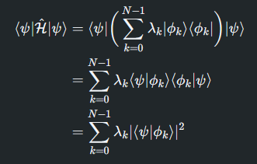
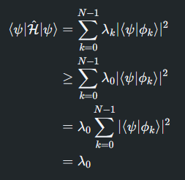

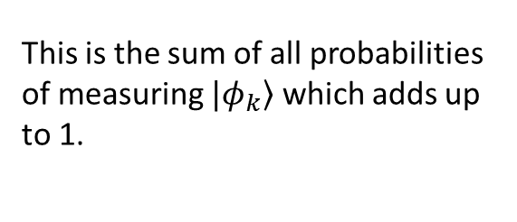
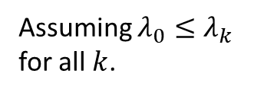
Why does this work?
We can calculate the expected energy of a system (expectation value of the observable):
We can show that the calculated expectation value is always higher than the ground state energy of the system:
Assuming $λ_{0}≤λ_{k}$ for all $k$.
This is the sum of all probabilities of measuring $|\left.φ_{k}\right\rangle$ which adds up to 1.
IBM Quantum

Slide 9


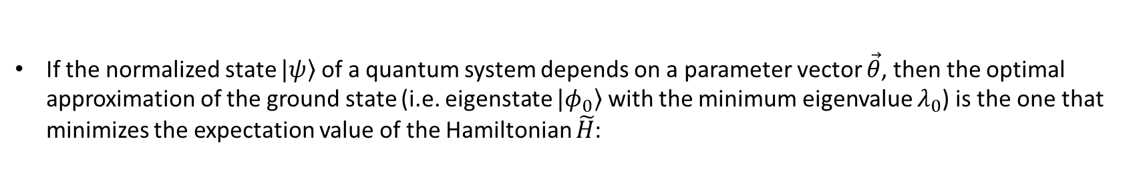

Variational theorem of quantum mechanics
Then considering the cost function, we can minimize the parameters to get close to the ground state solution:
If the normalized state $|\left.ψ\right\rangle$ of a quantum system depends on a parameter vector $\vec{θ}$, then the optimal approximation of the ground state (i.e. eigenstate $|\left.φ_{0}\right\rangle$ with the minimum eigenvalue $λ_{0}$) is the one that minimizes the expectation value of the Hamiltonian $\tilde{H}$:
We also make the following mathematical assumptions:
A finite lower bound to the energy $E≥λ_{0}>−∞$ needs to exist
Upper bounds do not generally exist
IBM Quantum

Slide 10
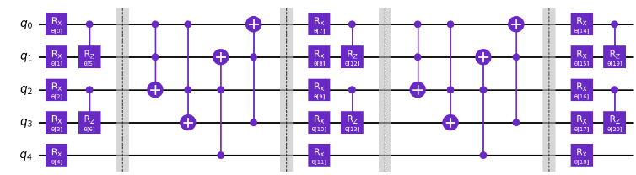
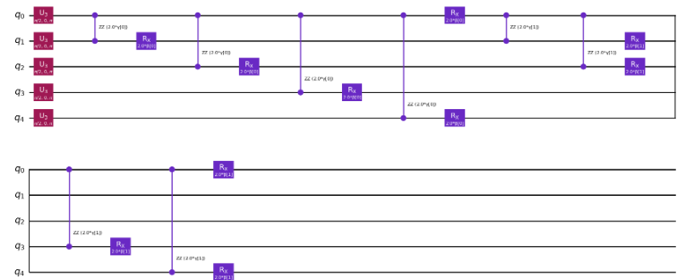
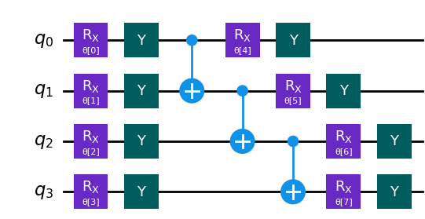

How to set up a variational algorithm
N-local ansatz
Problem specific ansatz for optimization
Hardware efficient ansatz
Problem specific ansatz for quantum machine learning
IBM Quantum

Slide 11
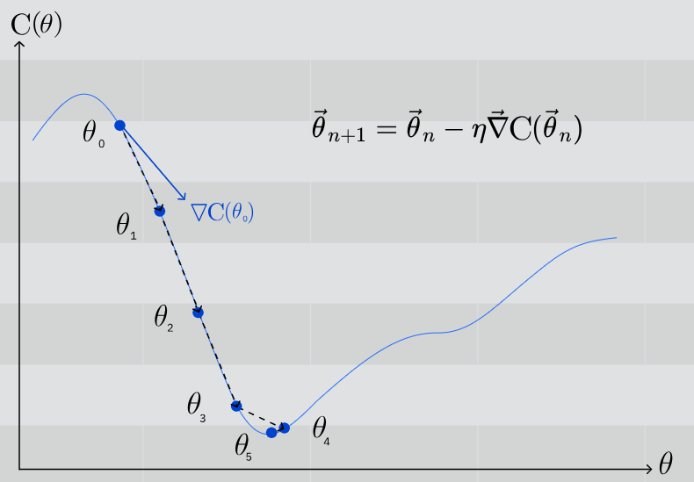
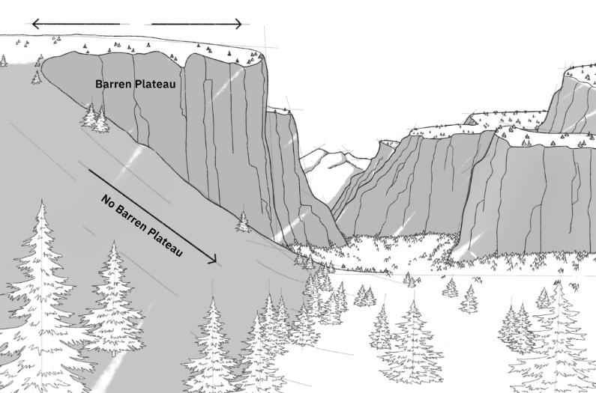
How to set up a variational algorithm
Qiskit library offers various ways to implement Cost functions as a sum of Pauli operators.
The primitives Estimator and Sampler can be used to compute expectation values of the operators in the variational loop.
Supports local and global classical optimizers. Depending on the application instance, you can choose gradient-based or gradient-free optimizers to update the parameters in the variational form.
IBM Quantum

Slide 12
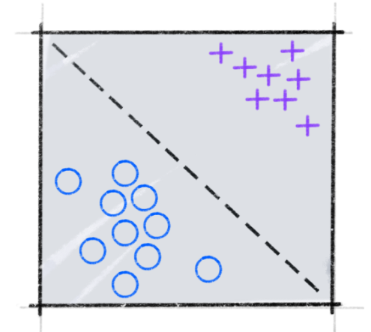
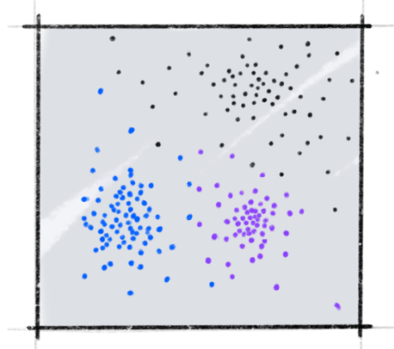
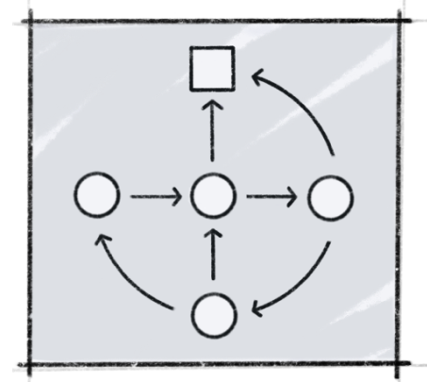
Quantum machine learning
Machine learning has established itself as a successful interdisciplinary field which seeks to find patterns in data. Throwing in quantum computing gives rise to interesting areas of research that aim to use the principles of quantum mechanics to augment machine learning, or vice-versa.
Supervised learning
Unsupervised learning
Reinforcement learning
IBM Quantum

Slide 13
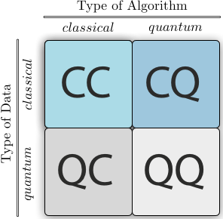
Quantum machine learning
Recently, most of the focus of CQ approaches to machine learning has been on near-term algorithms that can be executed on the current quantum devices.
Note that QML is still an active research area where we are already seeing results competitive with classical ML methods.
Many quantum algorithms have been proposed for QML, spanning all supervised, unsupervised and reinforcement learning models.
IBM Quantum

Slide 14
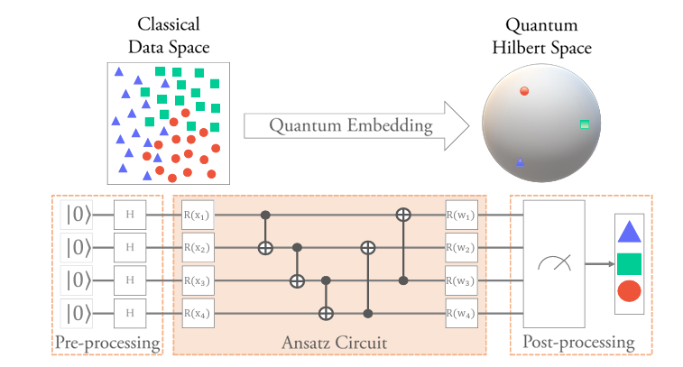
Data encoding
Data representation is crucial for the success of machine learning models. For classical machine learning, the problem is how to represent the data numerically, so that it can be best processed by a classical machine learning algorithm.
For quantum machine learning, this question is similar, but more fundamental: how to represent and efficiently input the data into a quantum system, so that it can be processed by a quantum machine learning algorithm. This is usually referred to as data encoding but is also called data embedding or loading.
Some common methods are:
Basis encoding
Amplitude encoding
Angle encoding
Arbitrary encoding
Image from: Quantum Embedding Search for Quantum Machine Learning, NamNguyen and Kwang-Chen Chen, IEEE
IBM Quantum

Slide 15
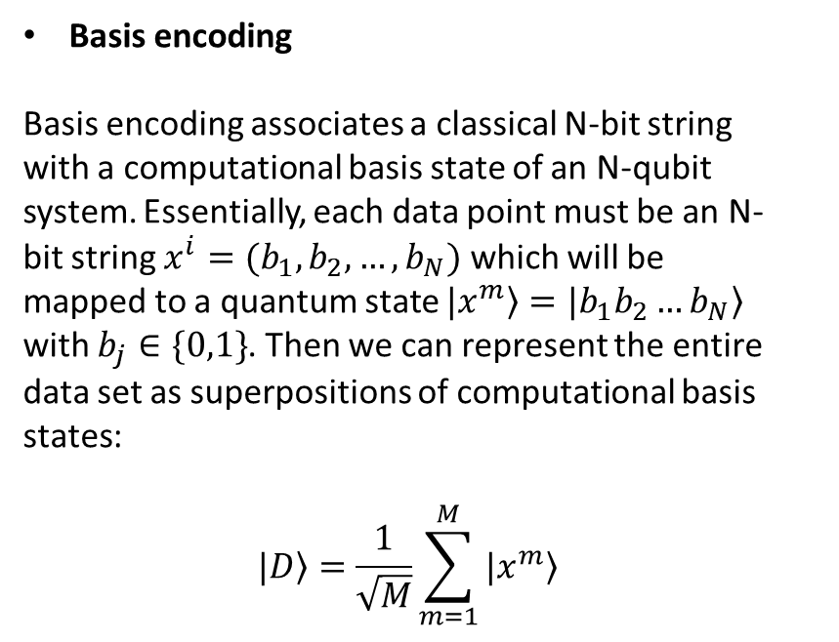
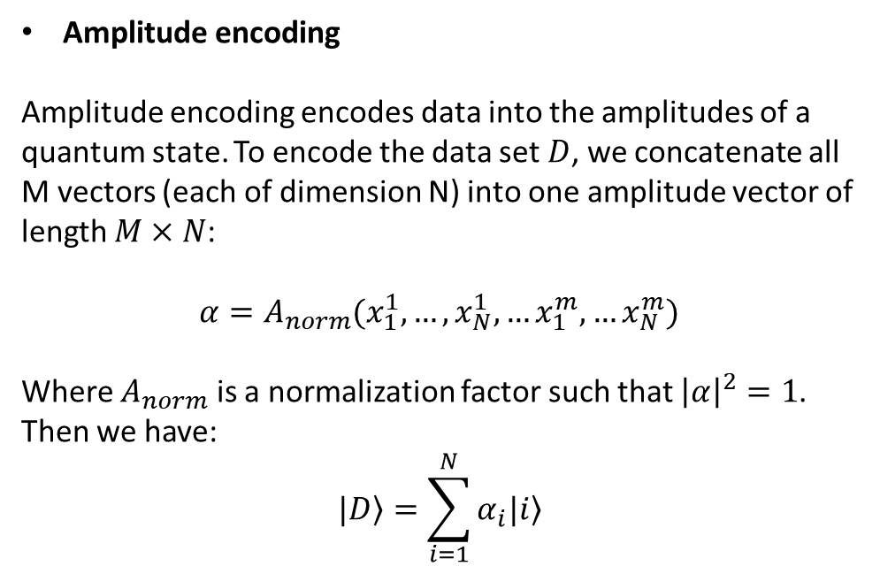
Data encoding
Given a data set with M samples, each with N features:
$D=\{ x^{1}, x^{2}, …, x^{M}\}$ where each $x^{i}$ is an N dimensional vector.
Basis encoding
Basis encoding associates a classical N-bit string with a computational basis state of an N-qubit system. Essentially, each data point must be an N-bit string $x^{i}=(b_{1}, b_{2}, …, b_{N})$ which will be mapped to a quantum state $|\left.x^{m}\right\rangle =|\left.b_{1}b_{2}…b_{N}\right\rangle$ with $b_{j}∈\{0,1\}$. Then we can represent the entire data set as superpositions of computational basis states:
$$|\left.D\right\rangle =\frac{1}{\sqrt{M}}\sum_{m=1}^{M}{|\left.x^{m}\right\rangle }$$
Amplitude encoding
Amplitude encoding encodes data into the amplitudes of a quantum state. To encode the data set $D$, we concatenate all M vectors (each of dimension N) into one amplitude vector of length $M×N$:
$$α=A_{norm}(x_{1}^{1}, …, x_{N}^{1}, …x_{1}^{m}, …x_{N}^{m})$$
Where $A_{norm}$ is a normalization factor such that ${\left|α\right|}^{2}=1$. Then we have:
$$|\left.D\right\rangle =\sum_{i=1}^{N}{α_{i}|\left.i\right\rangle }$$
IBM Quantum

Slide 16

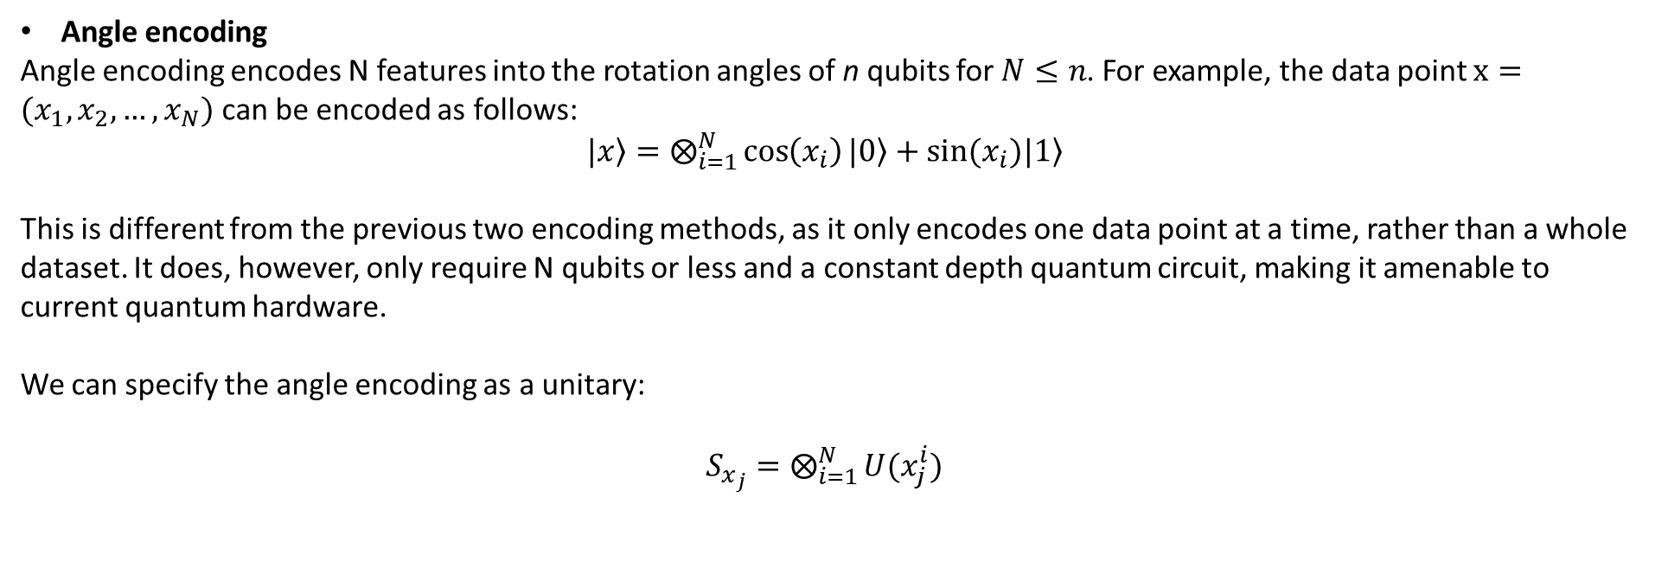
Data encoding
Given a data set with M samples, each with N features:
$D=\{ x^{1}, x^{2}, …, x^{M}\}$ where each $x^{i}$ is an N dimensional vector.
Angle encoding
Angle encoding encodes N features into the rotation angles of n qubits for $N≤n$. For example, the data point $x=(x_{1}, x_{2}, …, x_{N})$ can be encoded as follows:
$|\left.x\right\rangle =⨂_{i=1}^{N}{\cos\left(x_{i}\right)|\left.0\right\rangle +sin⁡(x_{i})|\left.1\right\rangle }$
This is different from the previous two encoding methods, as it only encodes one data point at a time, rather than a whole dataset. It does, however, only require N qubits or less and a constant depth quantum circuit, making it amenable to current quantum hardware.
We can specify the angle encoding as a unitary:
$S_{x_{j}}=⨂_{i=1}^{N}{U(x_{j}^{i})}$
IBM Quantum

Slide 17
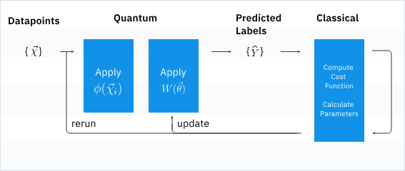
Quantum Support Vector Classifier (QSVC)
Variational quantum classifier (VQC) is the simplest classifier available in Qiskit Machine Learning and is a good starting point for newcomers to quantum machine learning who have a background in classical machine learning.
Two of its central elements are the feature map and ansatz.
Our data is classical, meaning it consists of a set of bits, not qubits. We need a way to encode the data as qubits. This process is crucial if we want to obtain an effective quantum model. This is the role of the feature map. While feature mapping is a common ML mechanism, this process of loading data into quantum states does not appear in classical machine learning as that only operates in the classical world.
IBM Quantum

Slide 18
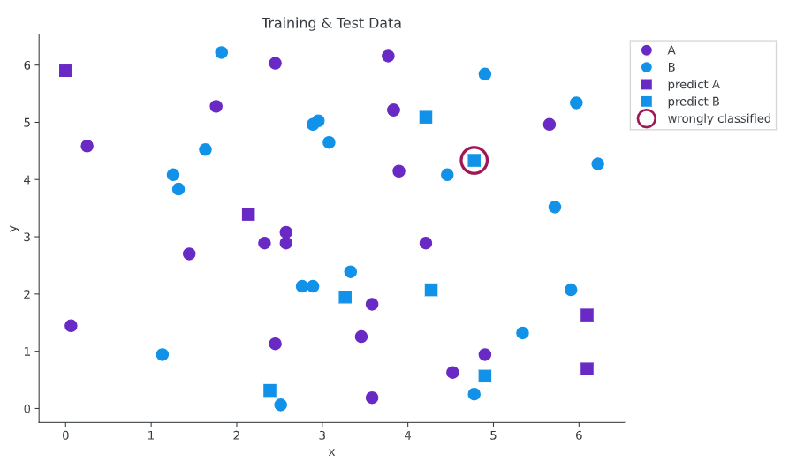
Variational quantum classifier
The variational quantum classifier is a variational algorithm where the measured expectation value is interpreted as the output of a classifier, introduced by multiple groups in 2018.
Very commonly used for classification problems (especially binary classification), hence it is a supervised learning algorithm.
Like the classical vector classifiers, after encoding the data as a quantum state, we train the variational ansatz to converge to optimal weights using the cost function.
IBM Quantum

